Slide 1
Frank Leisure And Events Pvt.Ltd.
Event Management Company

Slide 2
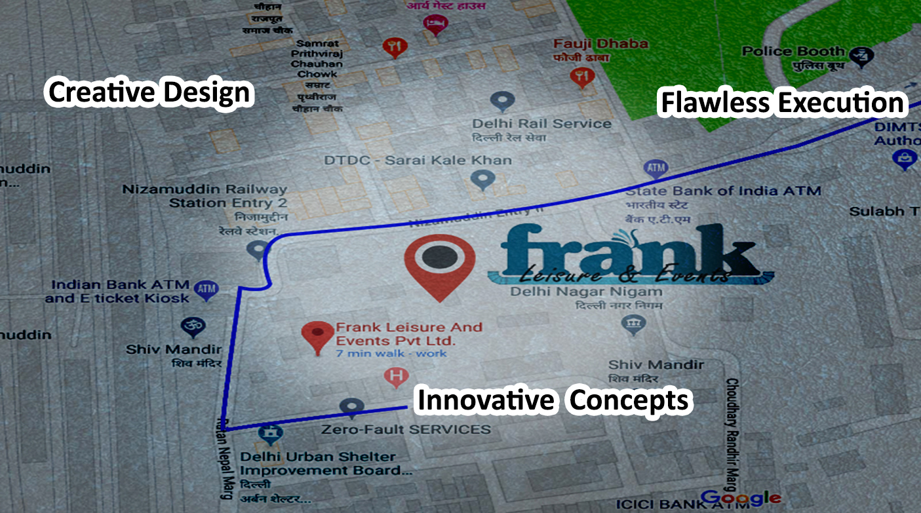

Slide 3
About Us
Frank Leisure is a leading event management company head quartered in Sarai
kale khan, New Delhi.
It’s one of the fastest growing companies in the field of Hospitality and Tourism. Our
company has been into existence since 2002. With a team of young, creative,
dynamic and dedicated professionals, we have pushed all areas of event
management to new frontiers, whether it is a Conference, Annual functions,
Dealer Engagement activity, Product launch, Meetings, Incentive tours, Training
program, Inauguration, Road show, Award functions, Exhibitions, Social
functions etc.
We have many reputed clients in the sector of NGO, Information Technology,
Pharmaceutical, Media, Entertainment, Production houses and Education.

Slide 5
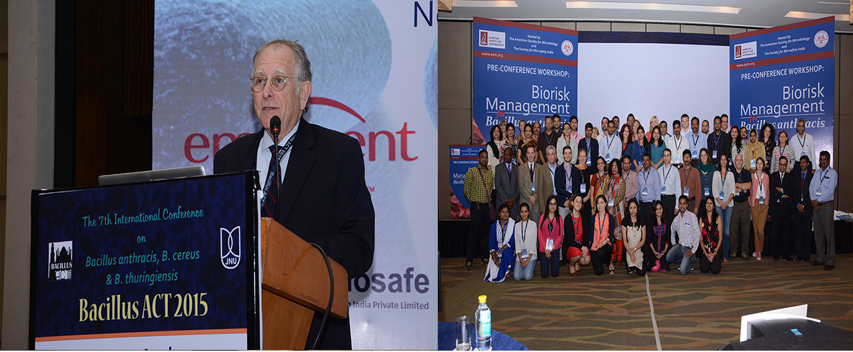
See Who We Are

Slide 6
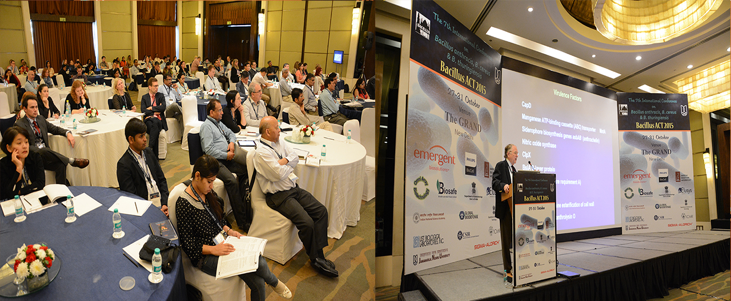
See Who We Are

Slide 7
See Who We Are

Slide 8
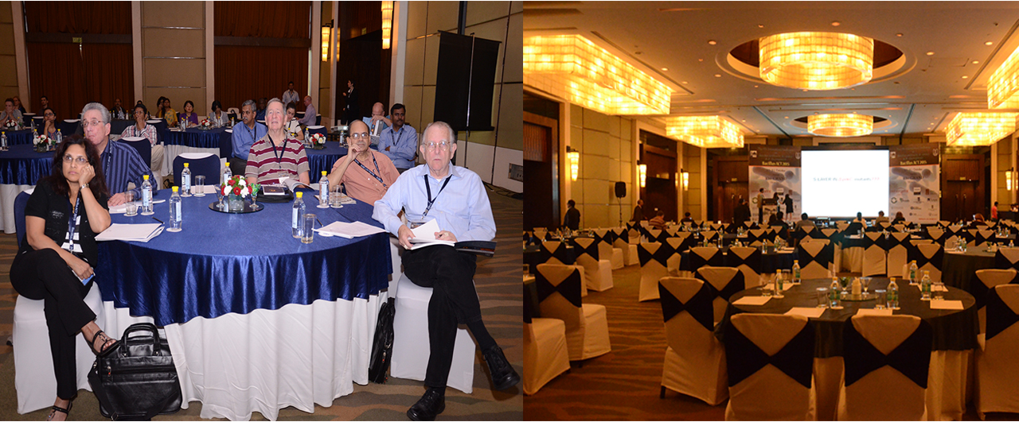
See Who We Are

Slide 9
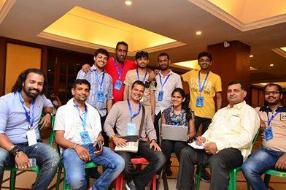
See Who We Are

Slide 10
We Deliver - travel solutions tailored to fit your needs and budget
We know - the best suppliers, and how to get the best price for you.
We go the extra mile - to make sure that you get the best out
of your chosen destination
We advise you - to maintain the Indian pursuit of perfection
and hospitality.
We are proud - being youngest Indian MICE company creating
footprints

Slide 11
Conference
Arrangements
Team Building
Activities
Itinerary Planning
& Designing
Celebrity Management
Services & Commitments
Venue/Hotel/
Resort Selection
Complete Budget
Preparation
Theme Parties, Gala Evenings,
Events, Award Night

Slide 12
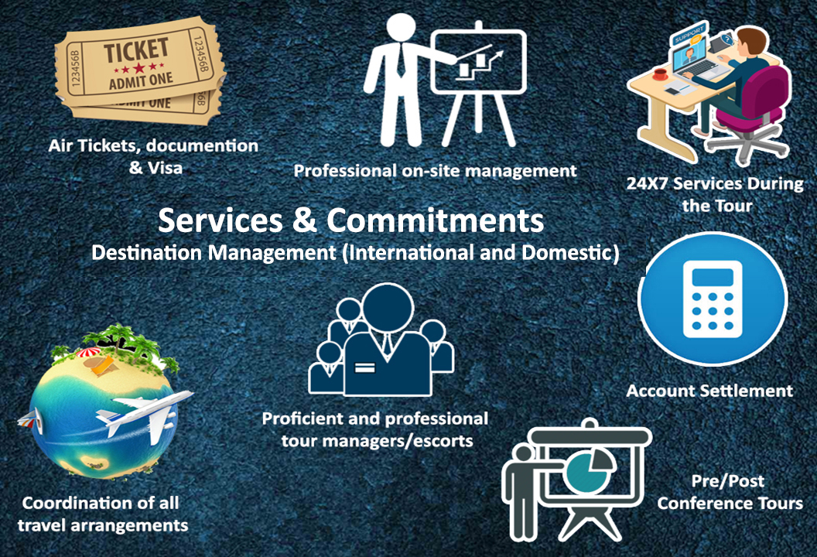

Slide 13
Our Strengths & Achievements
Young, experienced and trained professional staff
From premium tourism institutes
1000+ Projects handled and executed successfully
Over 20 year’s wealth of local contacts and knowledge
Seamless operation from city to city and country to country
5000 Pax handled in one go
More than 100 satisfied corporate and NGO’s

Slide 14
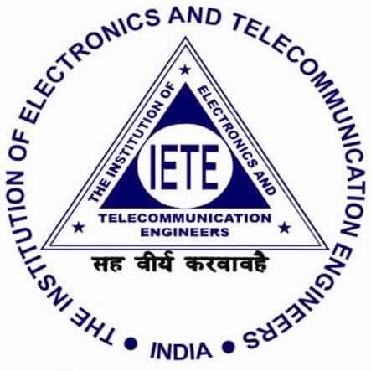
Our Experience With Brands

Slide 15
CSR – Corporate Social Responsibilities
We promote Eco Tourism by reducing Carbon Footprints
Responsible Tourism by conserving mother nature and generates greater economic benefits for local people and enhances the well-being of host communities, improves working conditions and access to the industry.
Environmental Tourism - We recommend sites/venues for MICE events at environment friendly destinations where the guests are free from environmental pollution, visual pollution.
Wellness Tourism - Our Tours include a travel for less stressful life to promote a healthier & balanced ones life.
Social Tourism - We make the guests socialize by using SIC Tours, Team Building activities, using local restaurants for lunches & dinners

Slide 16
Before The Good Bye
We Set up everything
… don’t worry about anything
You can be assured of a satisfying and timely response and service from Frank Leisure And Pvt. Ltd. We are always there for you to help you out.
Contact us through any mode of communication, one of our staff member will contact you as soon as possible.
18A Block-5 DDA Flats Sarai Kale Khan
New Delhi-110013, Near Mother Dairy
Phone:+91-11-24354632/+91-9599037488
Website : www.frankleisureandevents.com
Email : sales@frankleisureandevents. com

